Slide 1

Seaborn Group
House Developer Optimizer with Machine Learning Modelling
Albert Aldo
Elvin Fatkhunnuha
Mingnarto Lie
Final Project JCDS-12 Purwadhika

Slide 2









Meet Our Team (Seaborn Group)
Albert Aldo
Elvin Fatkhunnuha
Mingnarto Lie
Tarumanagara University Civil Engineering
Trisakti University
Mechanical Engineering
SAE Institute
3D Animation
As Project Manager
General Contractor
As Mechanical Engineer
As 3D Modeler & Lighting Artist

Slide 3
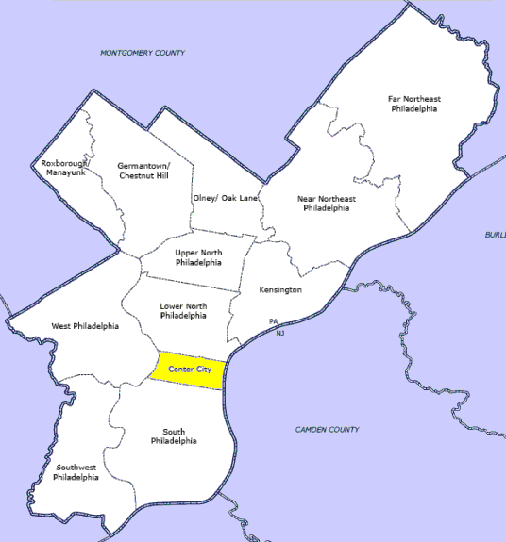

Philadelphia
Is a city in the state of Pennsylvania in United States.
Six-most populous city in the United States
Most Populous city in the state of Pennsylvania

Slide 4
BUSINESS PROBLEMS
&
GOALS

Slide 5

OUR PROJECTS
2 PERSPECTIVE FROM OUR PROJECTS
REGRESSION
(MARKET VALUE PROPERTY)
CLASSIFICATION
(SEGMENTATION MARKETING)

Slide 6
Business Problems
Marketing Valuation :
As a company that wants to expand its business property, a wide area will be needed to be acquired by the company to create a large cluster. Therefore, there will be a need of price benchmark when doing land acquisition around the cluster.
Segmentation :
Marketing department in the company hasn't used Clustering/Segmentation yet.
Marketing department tends to make offers that are not in accordance with the target segmentation.

Slide 7
Goals
Market Valuation
Segmentation
PROFIT
Having good price as a benchmark for house acquisition is one of the key factor of gaining profit for the company.
Determine the correct residential segmentation based on its type and the building size to fulfill customers' requests.
Goals
Goals
Houses’s market price valuation based on its specification, meanwhile the model can provide recommendations similar to the inputted specifications, for consideration when company buying their property
Property Segmentation for marketing purpose based on historical data

Slide 8
DATA UNDERSTANDING
&
DATA CLEANING

Slide 9


DATA COLLECTION
Data Source
Data Description
https://www.kaggle.com/adebayo/philadelphia-buildings-database
The dataset is published by the City of Philadelphia. Original source is from https://www.opendataphilly.org/ . The dataset is about building, property, housing with its specification and price.
Description of the columns was taken from www.metadata.phila.gov
Data contain:
461573 rows and 75 columns

Slide 10
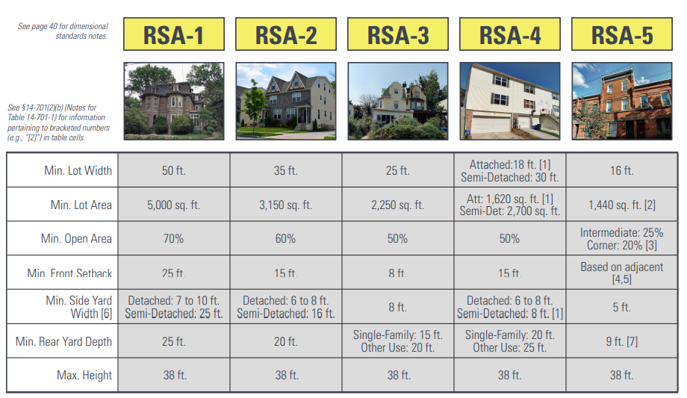
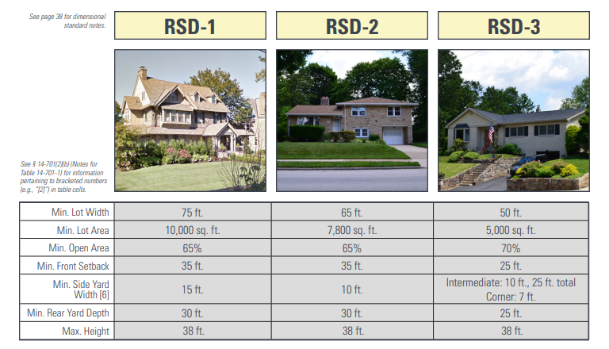
DATA CLEANING
Data Cleaning based on Residential Single Family
Zoning RSA & RSD

Slide 11


Data Cleaning
Columns to drop: assessment_date, cross_reference, date_exterior_condition, fuel, mailing_address_1, mailing_address_2, mailing_care_of, mailing_city_state, mailing_street, mailing_zip, market_value_date, other_building, owner_2, quality_grade, separate_utilities, sewer, site_type, street_direction, suffix, unfinished, unit, utility
Drop Columns
Several columns with more than 80% of null values
beginning_point, homestead_exemption, object_id
DataFrame’s Shape Before handling Drop Columns : (461573 rows , 75 columns)
Drop Columns
No information from metadata.philly.gov
DataFrame’s Shape After handling Drop Columns : (461573 rows , 25 columns)

Slide 12
Data Cleaning
We decided to handle the missing values we found. Using not applicable as substitute in several missing values we found in basements, central air, exterior condition, garage type, interior condition, type heater, and view type. The same goes with missing values in parcel shape and topography.
Handling
Missing Value
Some like depth, frontage, fireplaces we just do dropna.
DataFrame’s Shape Before Handling Missing Value : (461573 rows , 25 columns)
DataFrame’s Shape Before Handling Missing Value : (461556 rows , 25 columns)

Slide 13
Illogical Data Cleaning
Total livable area and total area equal to 0 ft2.
Number of bedrooms higher than number of rooms
Number of bedrooms, bathrooms, number of rooms equal to 0
Number of stories = 22 but low total livable area.
Number of stories = 0 but total area is lower than total livable area
Number of bedrooms + number of bathrooms higher than number of rooms
DataFrame’s Shape Before Illogical Data : (461573 rows , 25 columns)
DataFrame’s Shape Before Illogical Data: (77620 rows , 25 columns)

Slide 14
Data Understanding & Data Cleaning
Number_of_bedrooms : total number of bedrooms
Number_of_rooms : total number of rooms (bedroom, bathroom, livingroom, dining room, family room, library, kitchen)
Number_of_stories : This relates to elevation
Parcel shape : land shape
Street_designation : Identifiers of street names and serve to describe the street.
Topography : Types of topography of the house
Total_area : Total lot area
Total_livable_area : Total living area (building area).
Type_heater : Type of heater or heating system
View_type : view type of the property
Year_built : This is the year of the property was built
Zoning : This is a code which identifies the legal uses that are permitted at the property.
Basements : Type of basements
Building_code_description : This is a five-character code. It is a mixture of letters (alpha) or numeric
Central_air : ‘Y’ indicates there is central air, N indicates None space.
Depth : Measured from the principal street back to the rear property line or secondary street.
Exterior_condition : realtes to how the exterior appears based on the observation.
Fireplaces : Number of fireplaces
Frontage : when looking towards the site, this relates to the width of the lot as it abuts the principal streets
Garage_type : Off street parking is parking on the subject site.
Interior_condition : Indicate the overall condition of the interior
Location : house number, street code, unit number
Market_value :The certified market value of the property
Number_of_bathrooms : total number of bathrooms

Slide 15
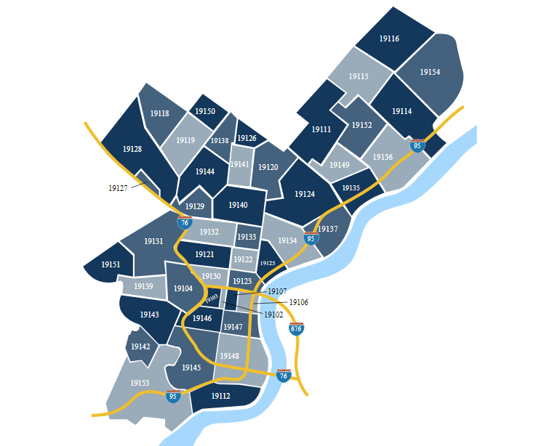
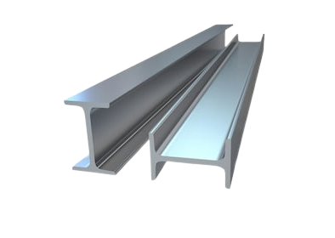

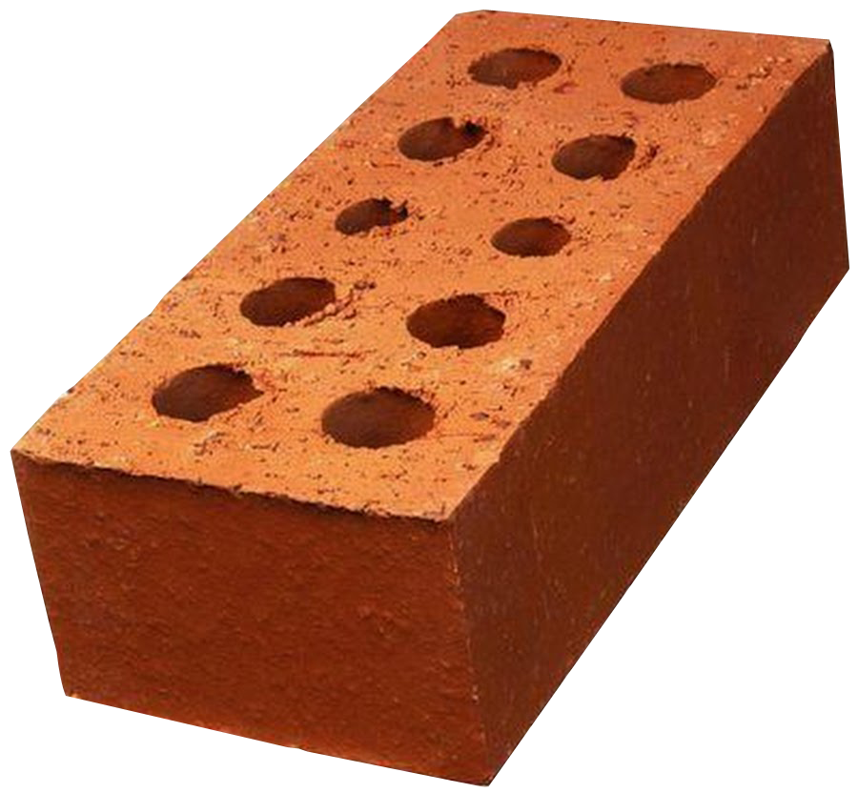
DATA CLEANING
Feature Extraction
Extract building code description into Construction Type
Extract zip code into Section
DataFrame’s Shape After Feature Extraction: (77620 rows , 26 columns)

Slide 16
UNSUPERVISED MACHINE LEARNING
(CLUSTERING)

Slide 17
UNSUPERVISED MACHINE LEARNING (CLUSTERING)
BEFORE
Marketing department in the company hasn't used Clustering/Segmentation yet
AFTER
Clustering/Segmentation being created in order for marketing department to sell our products right on target
Using our Project
Marketing department tends to make offers that are not in accordance with the target segmentation.
Marketing department becomes more effective and efficient in making offers to the appropriate target.

Slide 18




CLUSTERING
We use 4 features that might be the factor for segmentation:
Market Value
Lot Area
Clustering
Interpretation
Liveable Area
Zoning

Slide 19
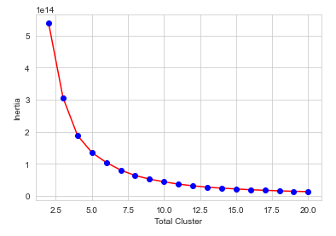
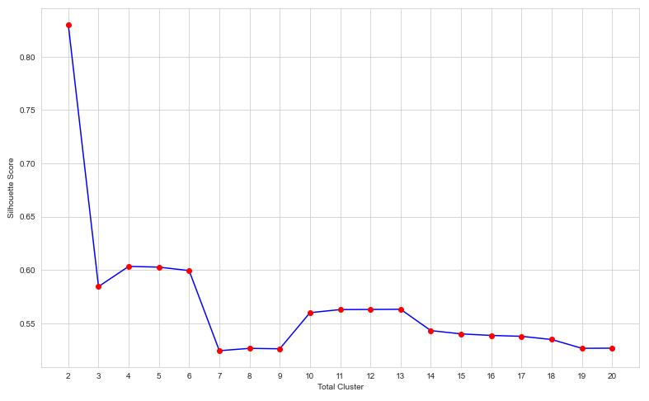
KMEANS CLUSTERING
Cluster Analysis
Cluster Analysis
Inertia
Silhouette Score
From elbow analysis the best number of cluster is 5
From Silhouette Score the best number of cluster is 2
We choose 5 clusters

Slide 20
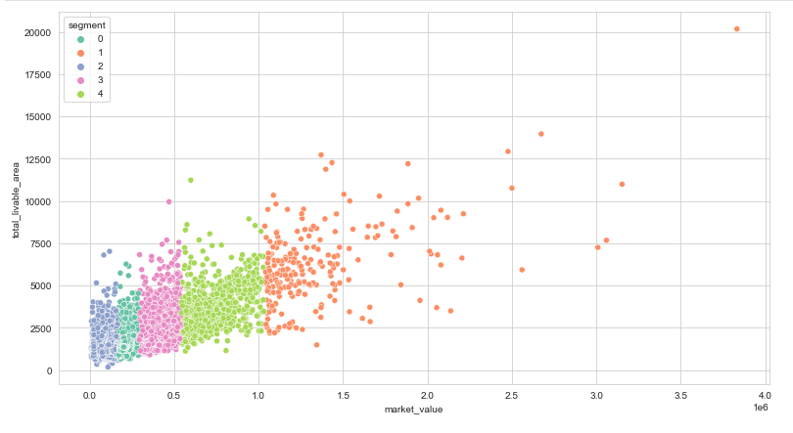
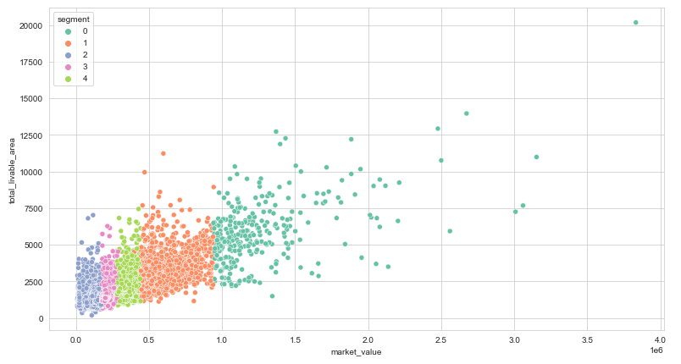
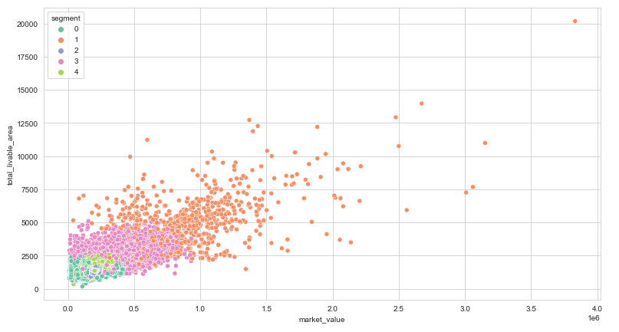
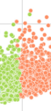
CLUSTERING
KMeans
Agglomerative Clustering
Gaussian Mixture

Slide 21
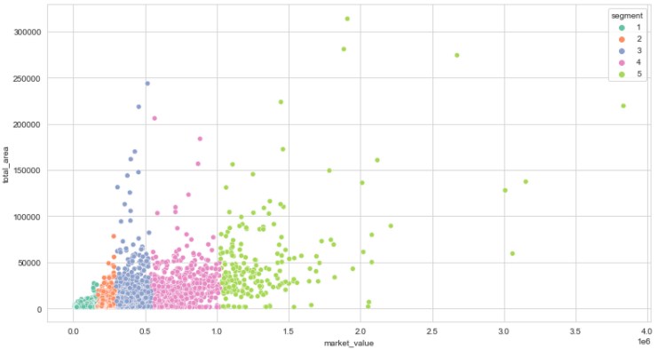
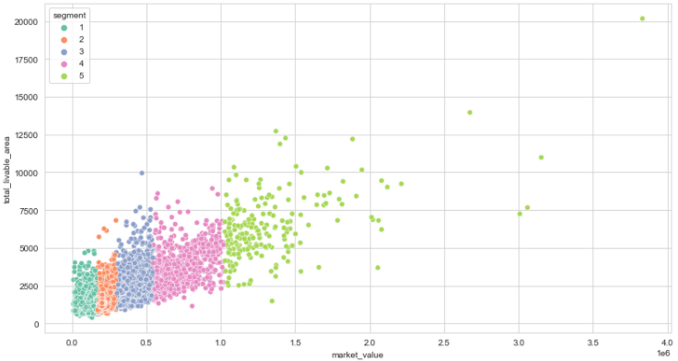
KMEANS CLUSTERING
Clustering Result
Market value and Total Area Segmented
Market value and Total Liveable Area Segmented

Slide 22
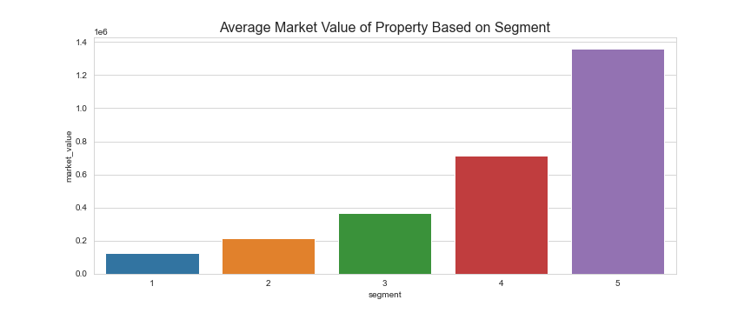
SEGMENT INTERPRETATION
SEGMENT VS MARKET VALUE
Segment 1 = Segment Low -> $8.5K - $169.3K
Segment 2 = Segment Lower Middle -> $151K - $289.8K
Segment 3 = Segment Middle -> $289.8K - $539.2K
Segment 4 = Segment Upper Middle -> $539.3K - $1,031.1K
Segment 5 = Segment Top -> $1,036.3K - $3,832.8K

Slide 23
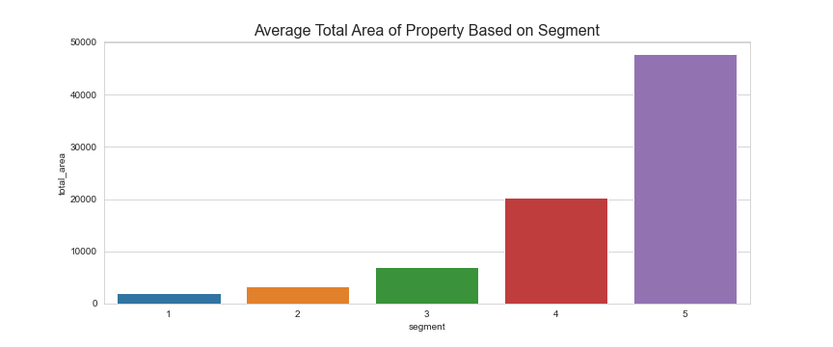
SEGMENT INTERPRETATION
SEGMENT VS TOTAL AREA
Segment 1 = Segment Low (Total Area : 1440 – 38640 sqft) -> Mean 1977.09 sqft
Segment 2 = Segment Lower Middle (Total Area : 1440 – 159170 sqft) -> Mean 3248.82 sqft
Segment 3 = Segment Middle (Total Area : 1440 – 243837 sqft) -> Mean 7055.22 sqft
Segment 4 = Segment Upper Middle (Total Area : 1440 – 25305 sqft) -> Mean 20280.73 sqft
Segment 5 = Segment Top (Total Area : 1458.07 – 313922 sqft) -> Mean 47759.45 sqft

Slide 24
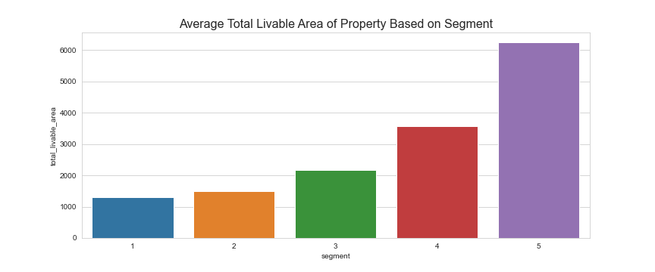
SEGMENT INTERPRETATION
SEGMENT VS TOTAL LIVEABLE AREA
Segment 1 = Segment Low (Total Livable Area : 176 – 7019 sqft) -> Mean 1304.56 sqft
Segment 2 = Segment Lower Middle (Total Livable Area : 600 – 6268 sqft) -> Mean 1505.74 sqft
Segment 3 = Segment Middle (Total Livable Area : 896 – 9950 sqft) -> Mean 2165.6 sqft
Segment 4 = Segment Upper Middle (Total Livable Area : 1120 – 11228 sqft) -> Mean 3573.48 sqft
Segment 5 = Segment Top (Total Livable Area : 1484 – 20172 sqft) -> Mean 6249.94 sqft

Slide 25
EXPLORATORY DATA ANALYSIS

Slide 26
• basements -> Type of basements
- 0 = None
- A = Full Finished
- B = Full Semi-Finished
- C = Full Unfinished
- D = Full – Unknown Finish
- E = Partial Finished
- F = Partial Semi-Finished
- G = Partial Unfinished
- H = Partial - Unknown Finish
- I = Unknown Size - Finished
- J = Unknown Size - Unfinished
• exterior_condition -> Relates to how the exterior appears based on observation.
- 2 = Newer Construction / Rehabbed
- 3 = Above Average
- 4 = Average
- 5 = Below Average
- 6 = Vacant – No occupancy
- 7 = Sealed / Structurally Compromised
• interior_condition -> Relates to how the interior appears based on observation.
- 2 = Newer Construction / Rehabbed
- 3 = Above Average
- 4 = Average
- 5 = Below Average
- 6 = Vacant – No occupancy
- 7 = Sealed / Structurally Compromised
• central_air
- Y – indicates there is central air.
- N – None space.
• garage_type
- 0 = None
- A = Basement / Built In
- B = Attached Garage
- C = Detached Garage
- F = Converted

Slide 27
• parcel_shape
- A = Irregular
- B = Grossly
- C = Triangular
- D = Right of Way
- E = Rectangular
• type_heater
- A = Hot Air (ducts)
- B = Hot Water (Radiators or Baseboards)
- C = Electric Baseboard
- D = Heat pump (outside unit)
- E = Other
- G = Radiant
- H = Undetermined
- 0 = None
• street_designation
ALY - Alley
AVE - Avenue
BLV - Boulevard
CIR - Circle
CT - Court
DR - Drive
HTS - Heights
LN - Lane
MEW - Mews
PK – Park
PKY - Parkway
PL - Place
PLZ - Plaza
RD - Road
ROW - Roadway
SQ - Square
ST - Street
TR - Terrace
WAY - Way
• topography
- A = Above Street Level
- B = Below Street Level
- C = Flood Plain
- D = Rocky
- E = Not Identified
- F = Level
• view_type
- I = Typical / Other.
- 0 = Not Applicable.
- A = Cityscape / Skyline
- B = Flowing Water
- C = Park/Green Area
- D = Commercial
- E = Industrial
- H = Edifice

Slide 28
EXPLORATORY DATA ANALYSIS
(REGRESSION)

Slide 29
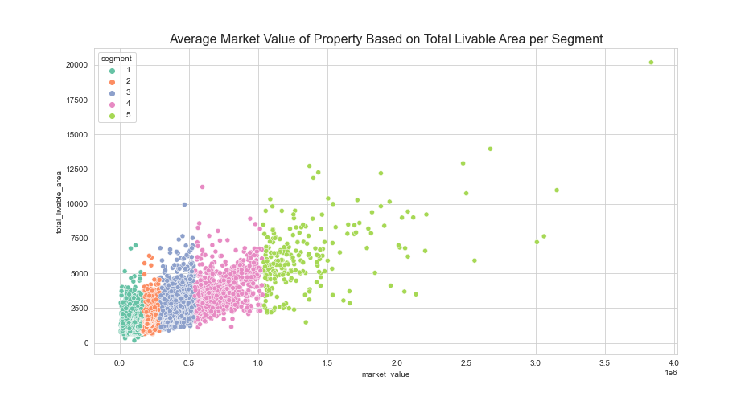
EXPLORATORY DATA ANALYSIS REGRESSION

Slide 30
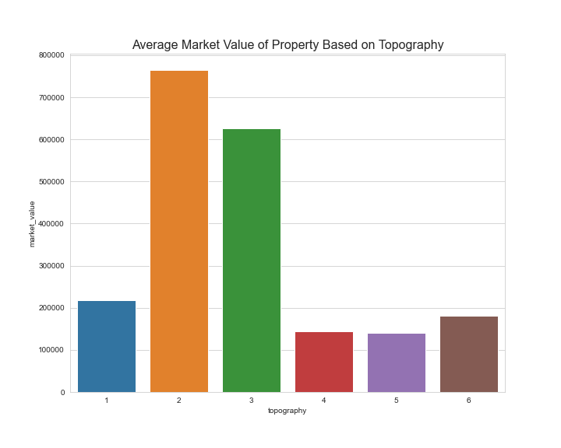
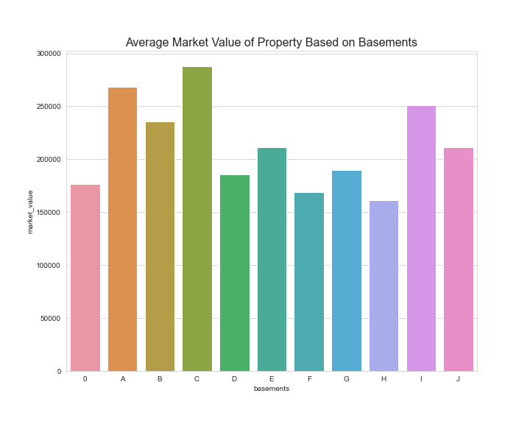
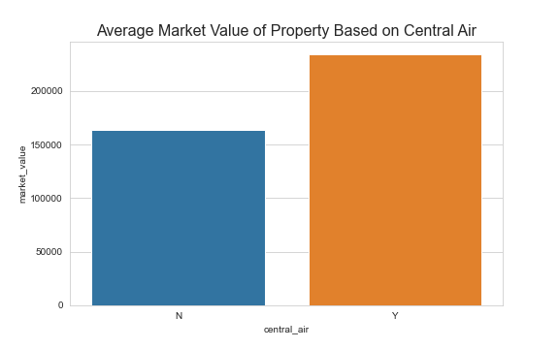
EXPLORATORY DATA ANALYSIS REGRESSION
Market Value
Based on Topography
Market Value
Based on Basements
Market Value
Based on Central Air

Slide 31
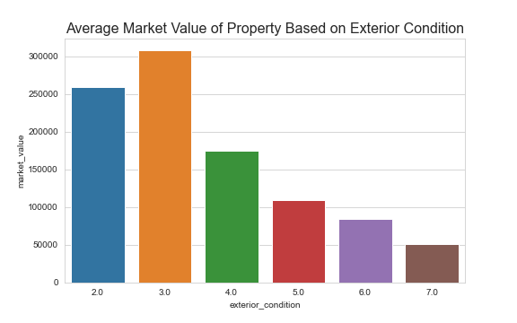
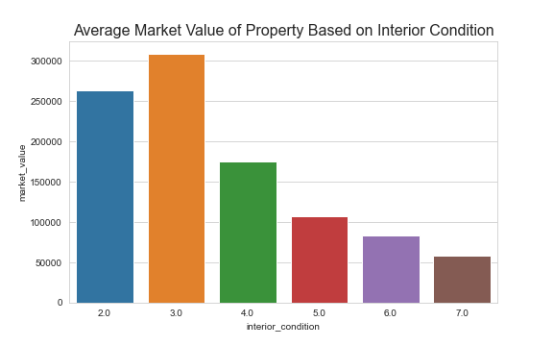
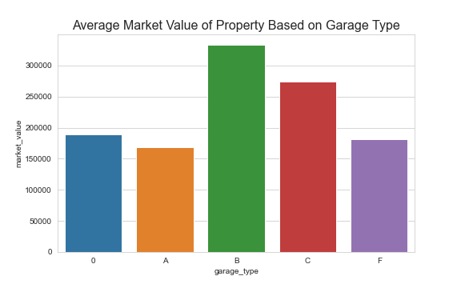
EXPLORATORY DATA ANALYSIS REGRESSION
Market Value
Based on Exterior Condition
Market Value
Based on Interior Condition
Market Value
Based on Garage Type

Slide 32
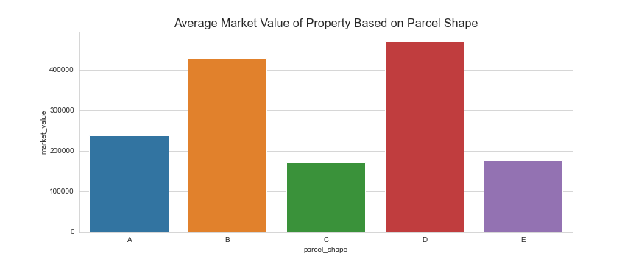
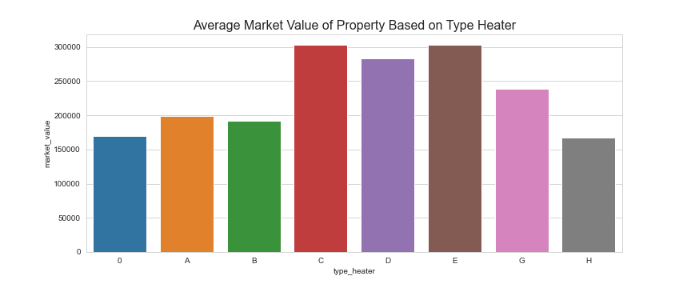
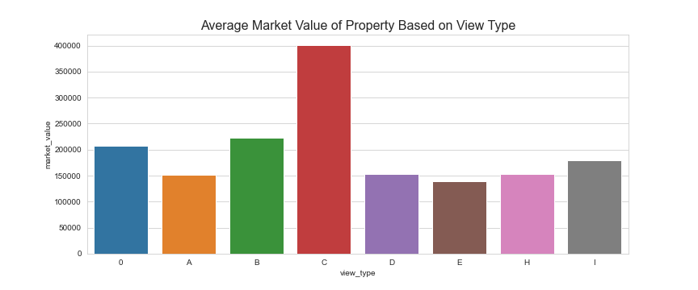
EXPLORATORY DATA ANALYSIS REGRESSION
Market Value
Based on Parcel Shape
Market Value
Based on Type Heater
Market Value
Based on View Type

Slide 33
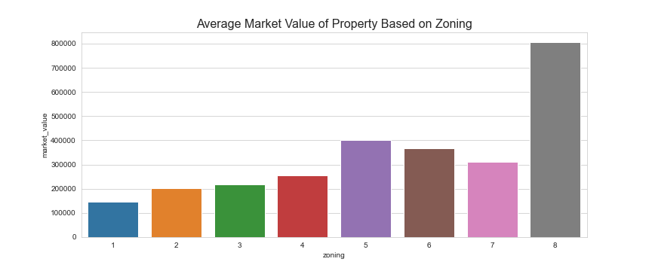
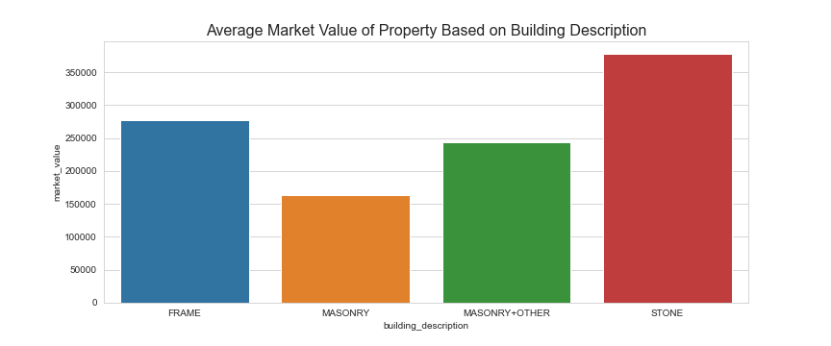
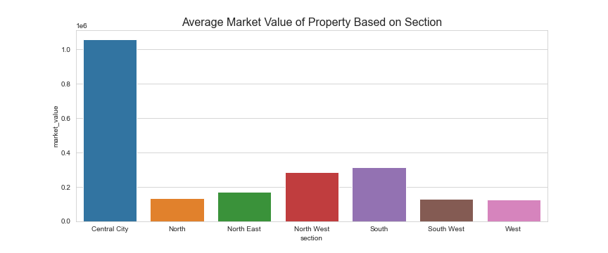
EXPLORATORY DATA ANALYSIS REGRESSION
Market Value
Based on Zoning
Market Value
Based on Building Description
Market Value
Based on Section

Slide 34
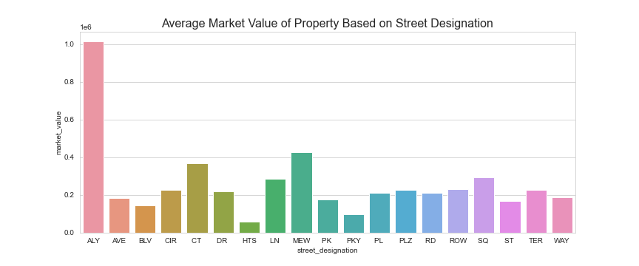
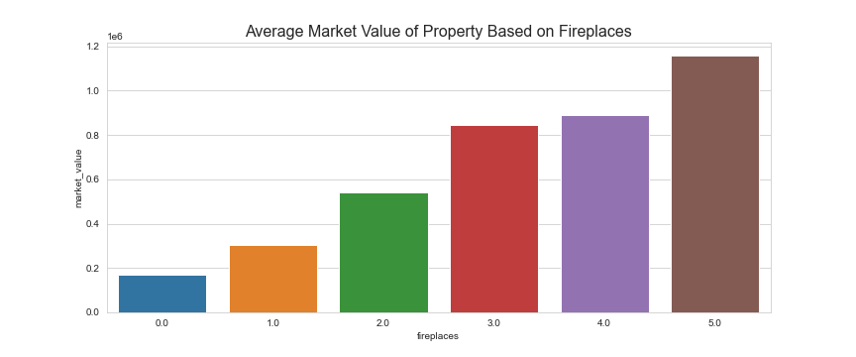
EXPLORATORY DATA ANALYSIS REGRESSION
Market Value
Based on Street Designation
Market Value
Based on Fireplaces

Slide 35
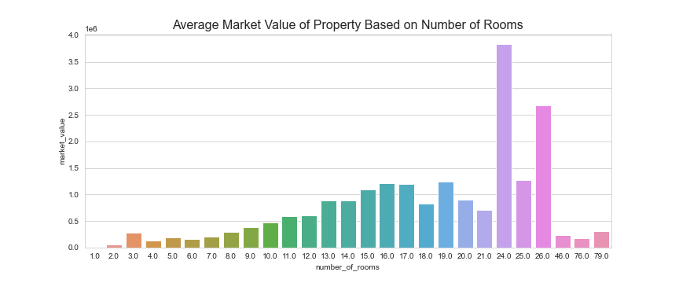
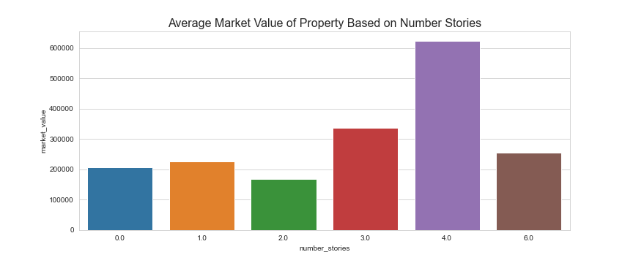
EXPLORATORY DATA ANALYSIS REGRESSION
Market Value
Based on Number of Rooms
Market Value
Based on Number Stories

Slide 36
EXPLORATORY DATA ANALYSIS
(CLASSIFICATION)

Slide 37
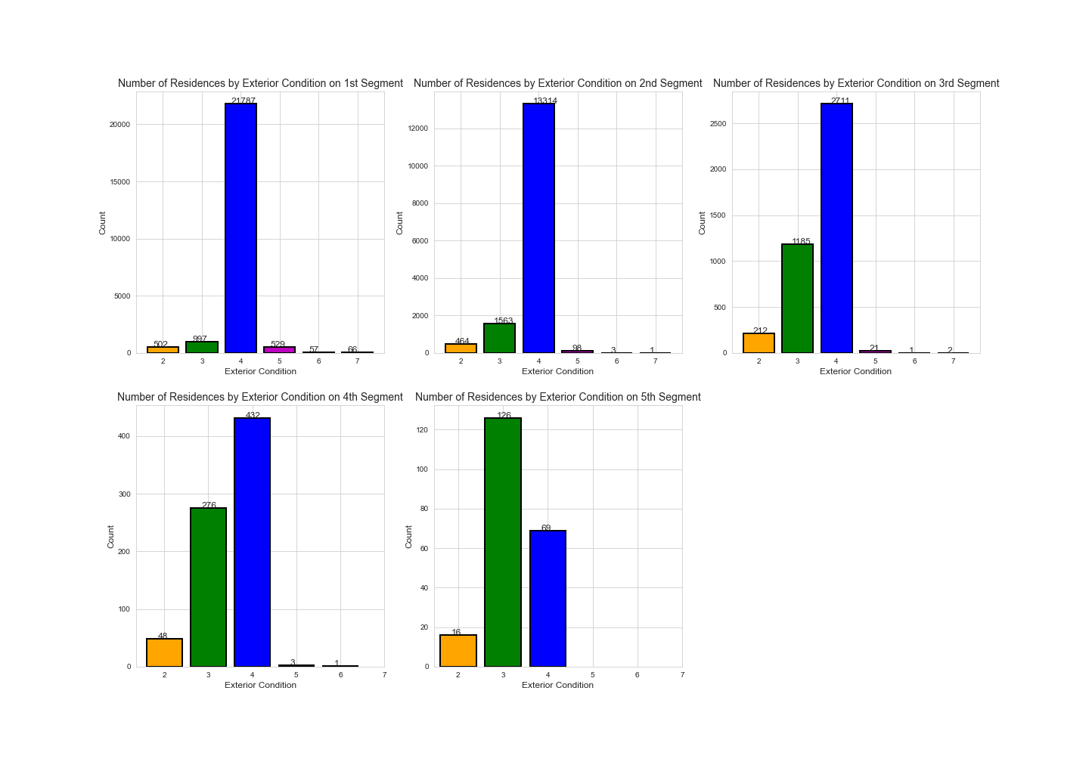
Exploratory Data Analysis Classification
Segmentation based on Exterior Condition

Slide 38

Exploratory Data Analysis Classification
Segmentation based on Interior Condition

Slide 39
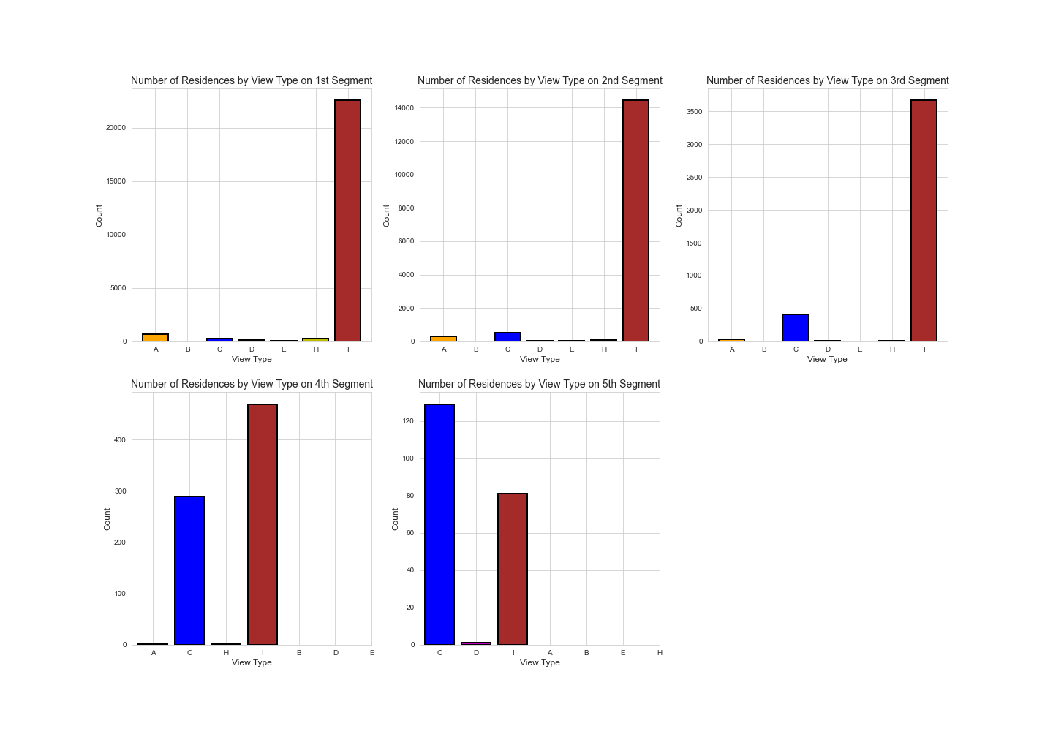
Exploratory Data Analysis Classification
Segmentation based on View Type

Slide 40
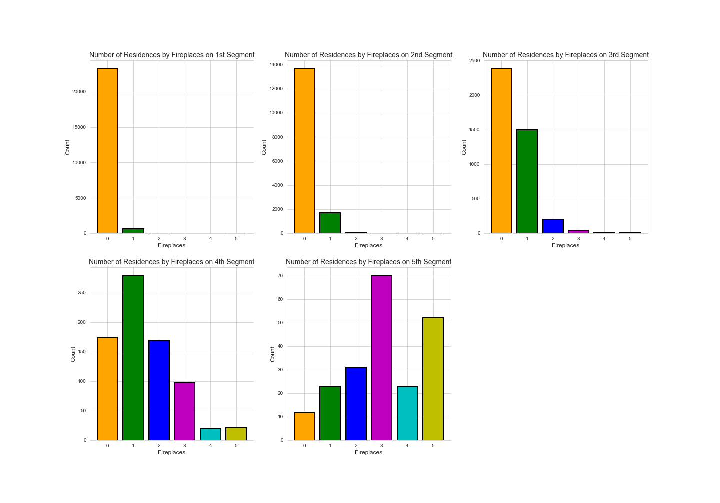
Exploratory Data Analysis Classification
Segmentation based on Fireplaces

Slide 41
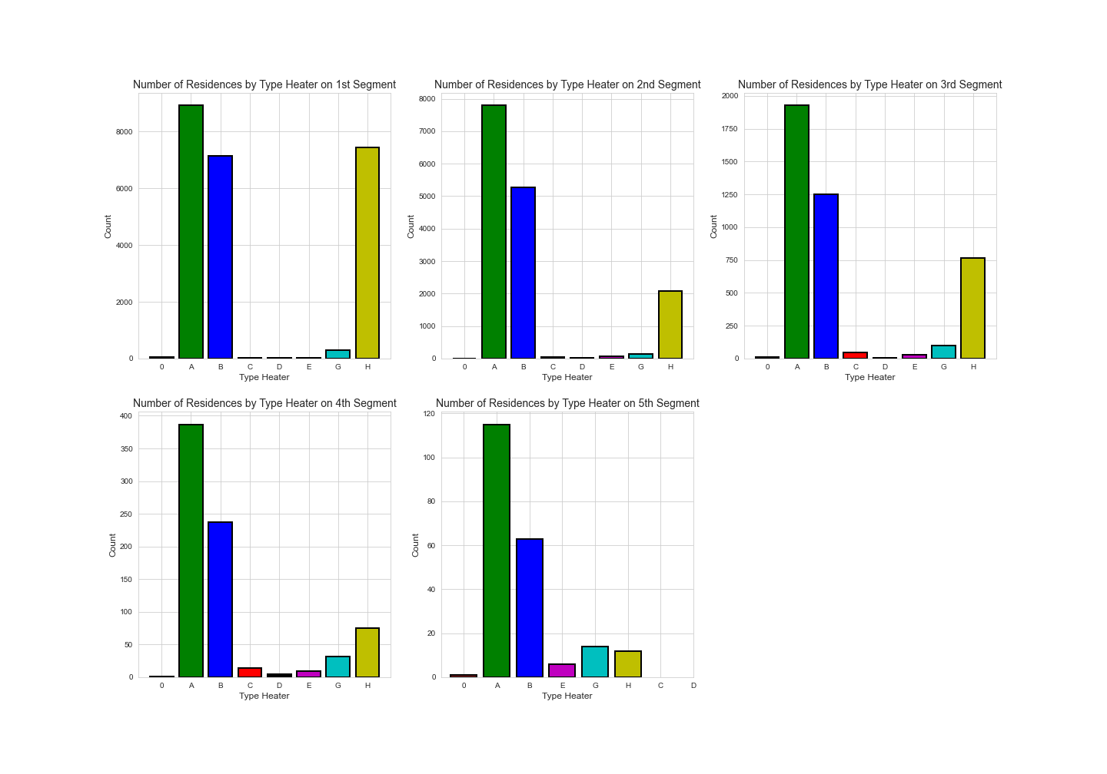
Exploratory Data Analysis Classification
Segmentation based on Type Heater

Slide 42
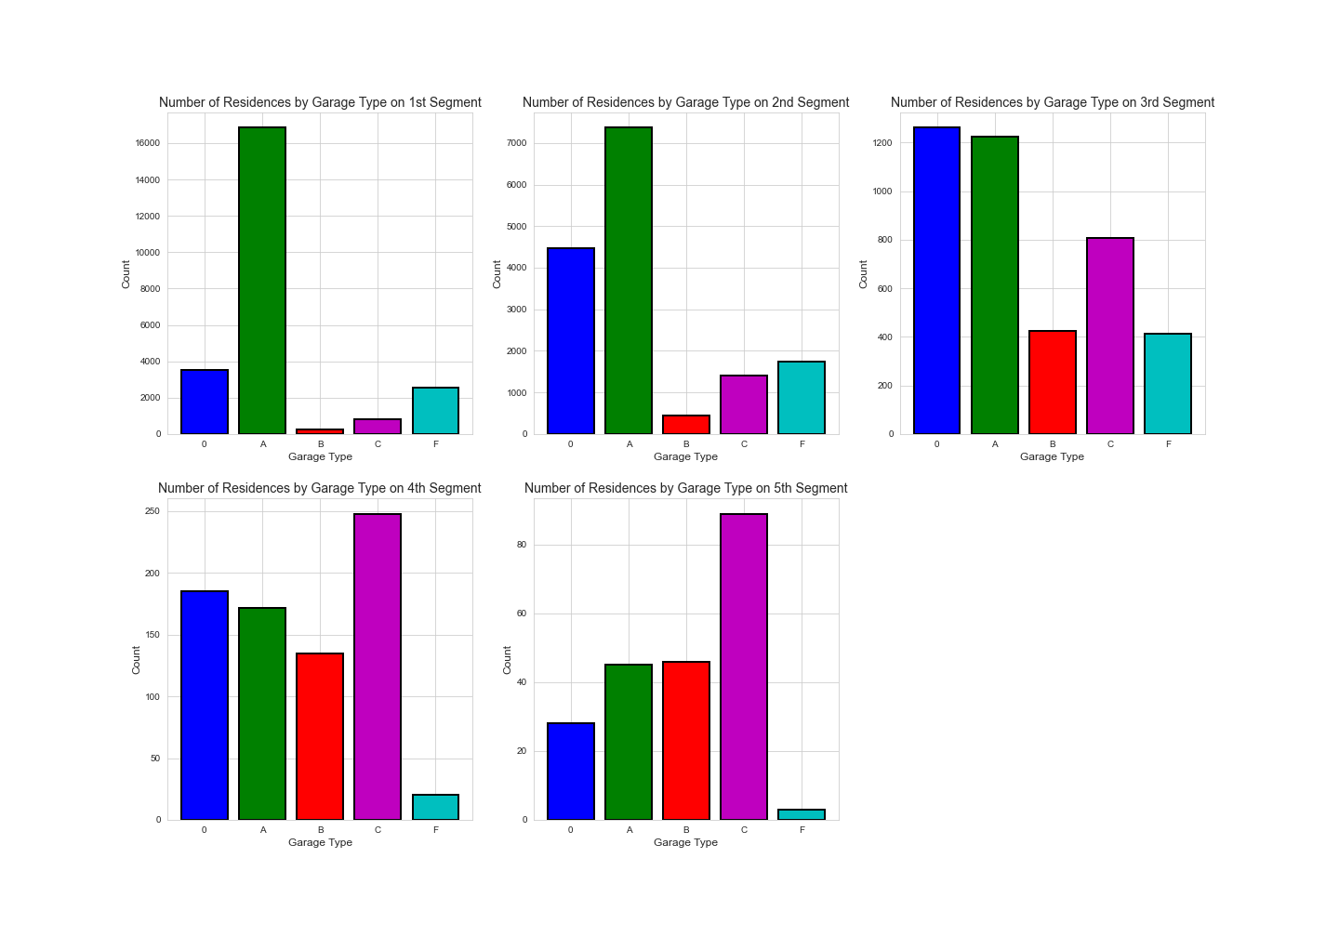
Exploratory Data Analysis Classification
Segmentation based on Garage Type

Slide 43
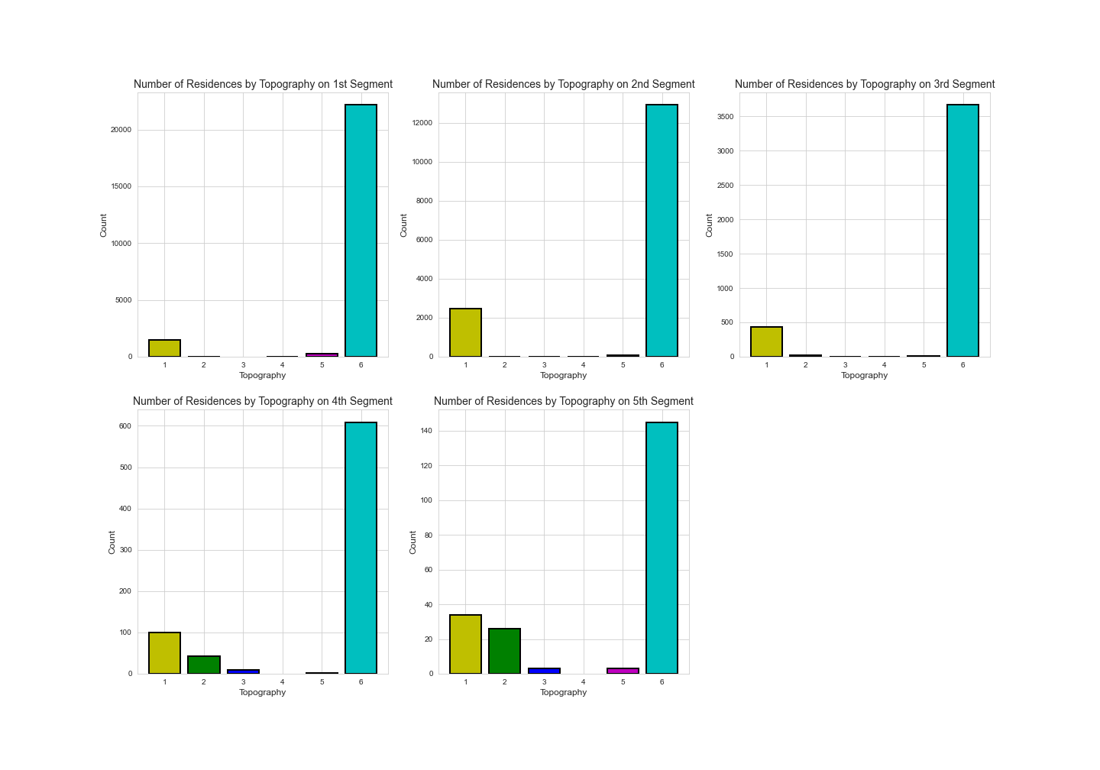
Exploratory Data Analysis Classification
Segmentation based on Topography

Slide 44
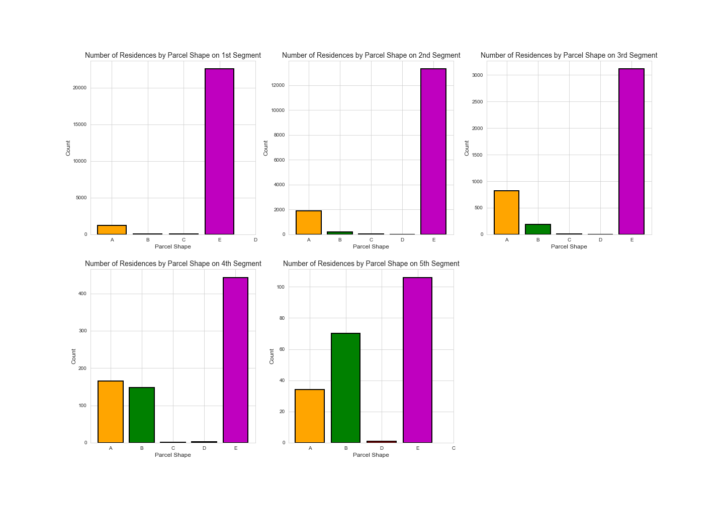
Exploratory Data Analysis Classification
Segmentation based on Parcel Shape

Slide 45
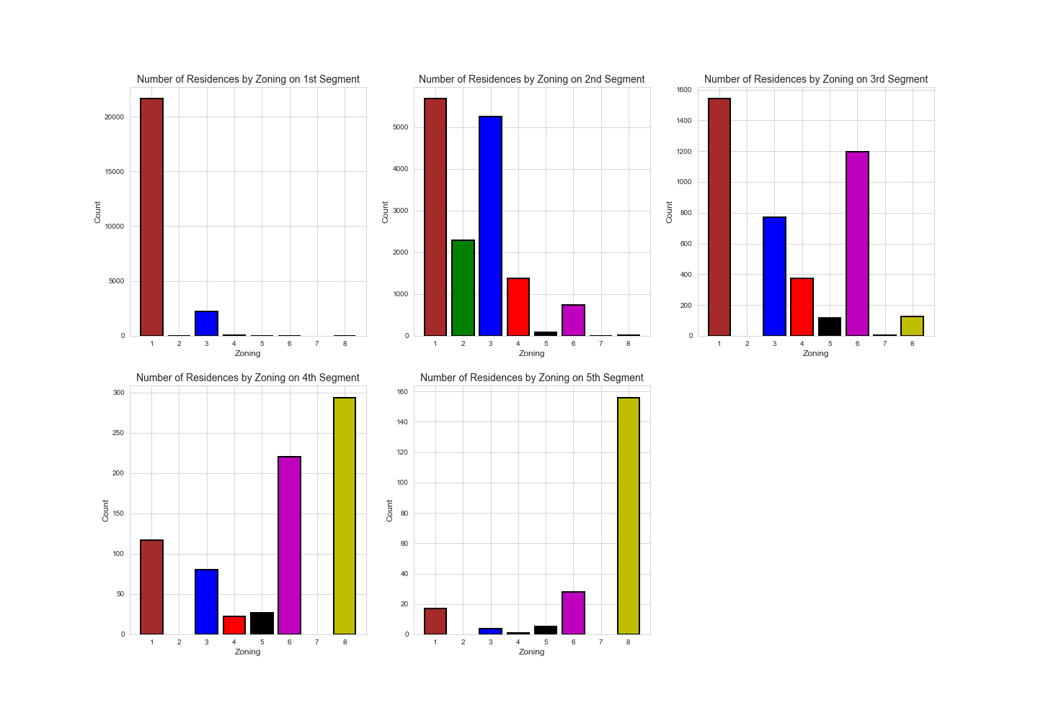
Exploratory Data Analysis Classification
Segmentation based on Zoning

Slide 46
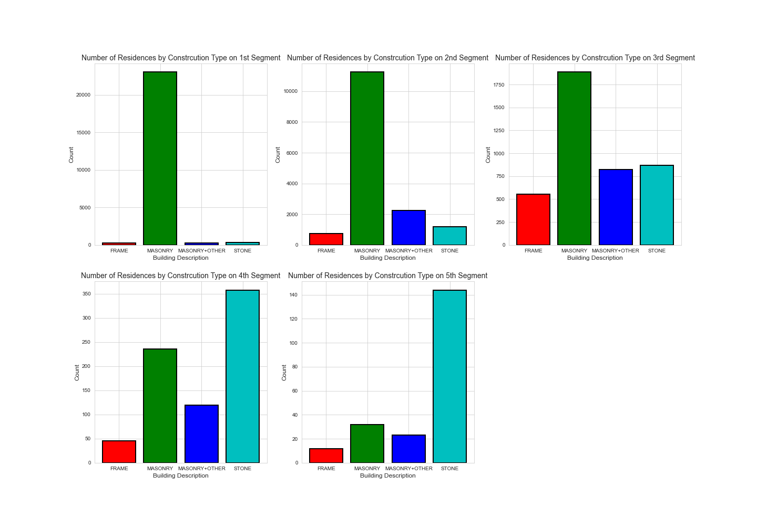
Exploratory Data Analysis Classification
Segmentation based on Building Description

Slide 47
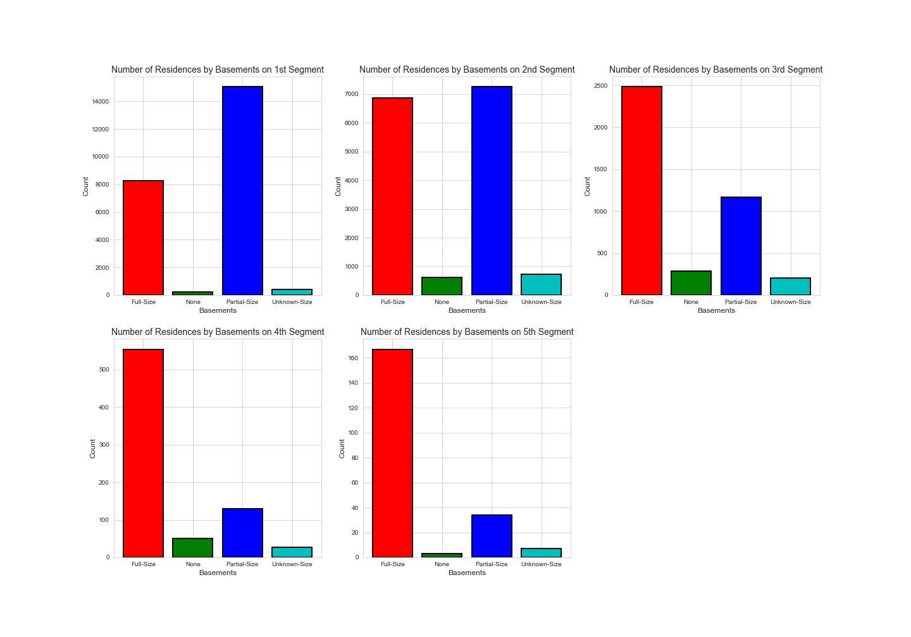
Exploratory Data Analysis Classification
Segmentation based on Basements

Slide 48
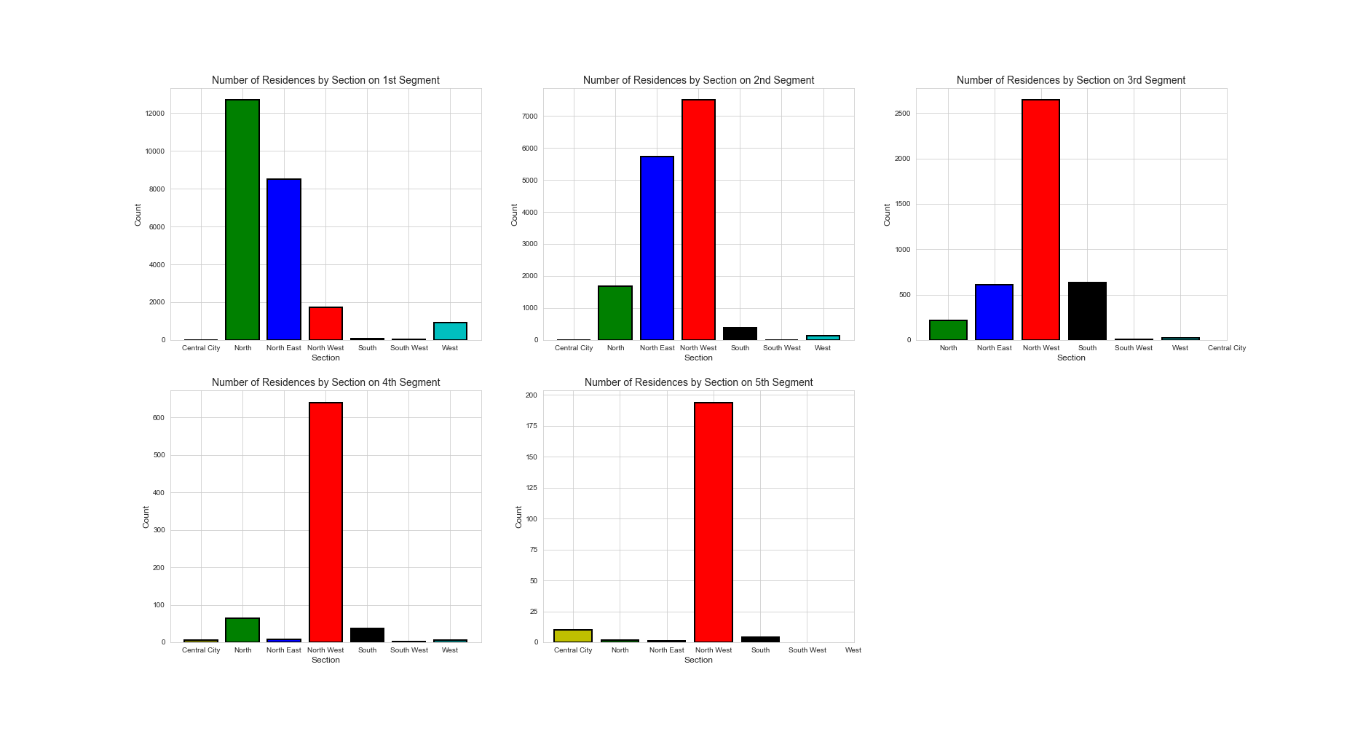
Exploratory Data Analysis Classification
Segmentation based on Section

Slide 49
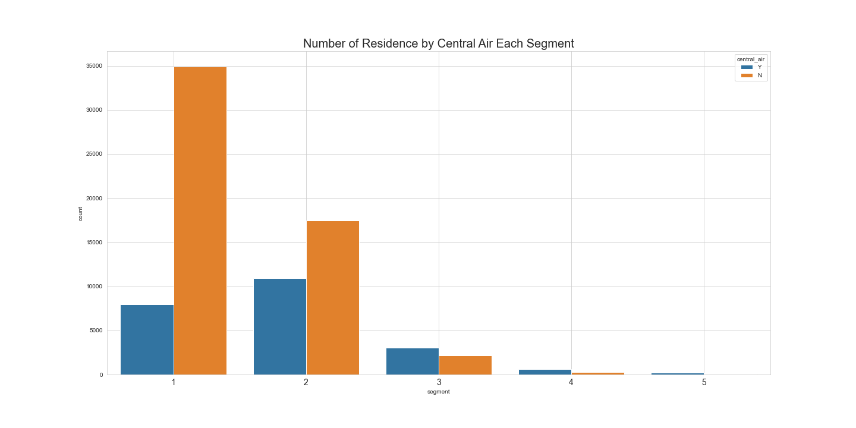
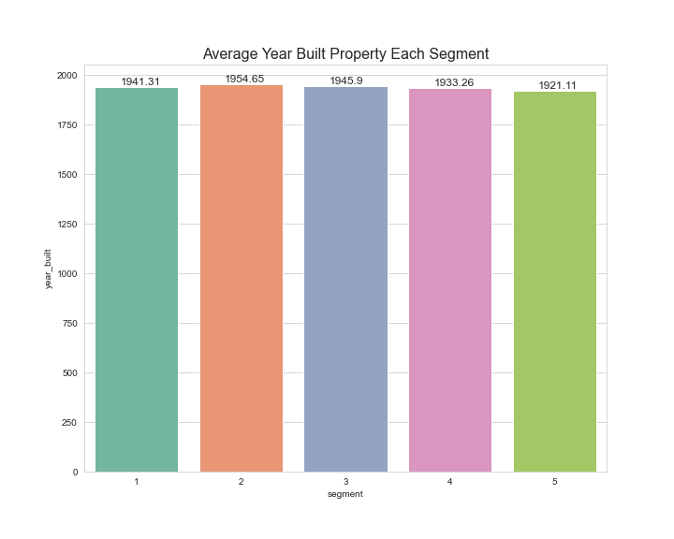
EXPLORATORY DATA ANALYSIS CLASSIFICATION
Segmentation based on Central Air
Segmentation based on Year Built

Slide 50
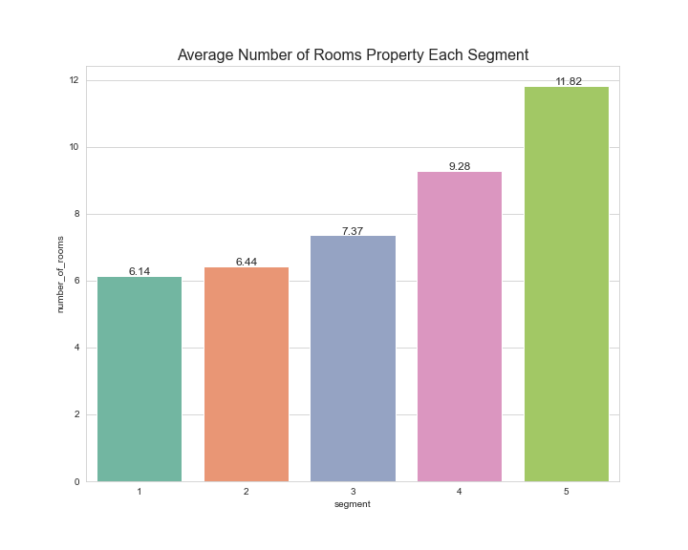
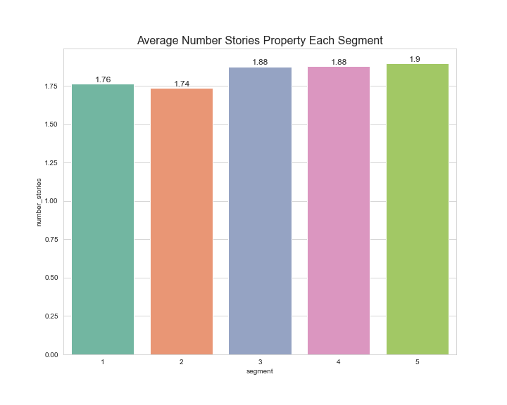
EXPLORATORY DATA ANALYSIS CLASSIFICATION
Segmentation based on Number of Rooms
Segmentation based on Number Stories

Slide 51
MACHINE LEARNING MODELLING
(REGRESSION)

Slide 52
Machine Learning Modelling
The regression problem was to predict the price of the house based on its specification
01
Feature Selection
Encoding
Encoding categorical features
Scaling numerical features
02
Market Value Prediction Modelling Steps
Training and Evaluating Model
03
Hyperparameter Tuning & Fine tuning (if needed)
04

Slide 53
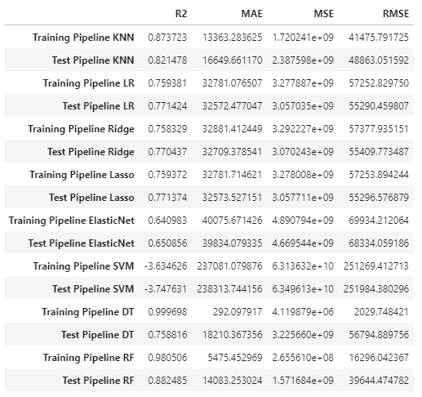

Base Model
Hyperparameter Tuning
KNN base model having the best R2 score but it still over fit. After doing hyperparameter tuning the R2 score for test data is overfitting. We are not going to continue fine tuning with KNN because it is too long to process (needs more resources)
Linear regression R2 score categorized as good learner with R2 score of 0.75 on training and 0.77 on testing with MAE of 32572.477.
Decision tree regressor categorized as strong learner causing the model to struggle in predicting new /unseen data. So we want to decrease overfit while still retaining a good R2 and MAE
We choose the best model based on R2 score and mean absolute error (MAE)

Slide 54


Fine Tuned Decision Tree
Train
Test
R2: 0.818
MAE: 20350.7
MSE: 2.4777e+09
RMSE: 49776.09
R2: 0.774
MAE: 22407.63
MSE: 3.0197e+09
RMSE: 54951.45
This model has 31.2% lower in mean average score than the Linear Regression Model. So we choose the model as our main machine learning algorithm

Slide 55
Recommender System Workflow
1
Company received house specification on specific area that they want to buy.
2
Based on the house specifications we have, recommendation will be made using several variables such as market value, total area, total livable area, building description, section, exterior & interior condition.
3
The recommendation system goes by changing several variables into Matrix using CountVectorizer and transform them into model using Cosine Similarity.
4
5
We search for similarity between user's inputs and our data using Cosine Similarity model.
Recommendation results are ready to launch.

Slide 56
MACHINE LEARNING MODELLING
(CLASSIFICATION)

Slide 57
01
Feature Selection
Encoding
Encoding categorical features
02
Training and Evaluating Model
Residences Classification Modelling Steps
03
04
Feature Engineering
Hyperparameter & Fine Tuning
05
06
Evaluating Model

Slide 58

Multiclass Classification:
SEGMENT 1 -> LOW
SEGMENT 2 -> LOWER MIDDLE
SEGMENT 3 -> MIDDLE
SEGMENT 4 -> UPPER MIDDLE
SEGMENT 5 -> TOP
High marks (Strong Learner) are KNN, SVM, DecisionTreeClassifier, RandomForestClassifier. LogisticRegression is having 0.77 Accuracy Score in Train Data and Test Data.

Slide 59




Fine-Tuned Decision Tree Classifier
Data Composition
Although, the accuracy score of decision tree classifier is 96%,
due to imbalanced data, the top segment is having 0 f1-score. It means that the model is having issues in predicting the top segment.
Our approach is to balance out the data using random over sampling on minority class
Fine-tuned Random Forest Classifier on Balanced Dataset
Training Model after Random Over Sampling
The accuracy score of random forest classifier on balanced dataset is 96 for train and test data. It has also better f1-score on every segment.

Slide 60
PROJECT RECOMMENDATION
&
BUSINESS IMPACT

Slide 61

PROJECT RECOMMENDATION REGRESSION
There are lots of Properties in the North, North East and quite cheap to purchase therefore we can buy and redeveloped them into cluster to be sold on the latter-day with higher price.

Slide 62

PROJECT RECOMMENDATION CLASSIFICATION
Assumption :
- Equal sales performance across the board
- Fifth segment managed higher profit
- Recommended to prioritize this segment

Slide 63
CONCLUSION
&
RECOMMENDATION

Slide 64

CONCLUSION & RECOMMENDATION
The company able to determine which house selling segmentation accurately using our Machine Learning (Classification).
The company able to get a benchmark of the house they try to buy using Machine Learning (Regression), so the negotiation process can be faster and increase our profit since we will be able to determine good price.
But to achieve these two goals, a large amount of data will be required to support our Machine Learning.
There is a weakness in our Regression Machine Learning. It has a hard time in predicting old houses' prices. To counter this problem, the company able to hired an expert in predicting these types of houses' prices.

Slide 65
THANK YOU FOR YOUR ATTENTION

